Slide 1
Applied Statistical Analysis
Theoretical Probability Distributions

Slide 2
Random Number
Statistics is concerned with making inferences about populations and population characteristics.
Experiments are conducted with results that are subject to chance.
It is often important to allocate a numerical description to the outcome.
Example the sample space when three electronic components are tested
S={NNN,NND,NDN,DNN,NDD,DND,DDN,DDD}
N-Non Detective, D- Defective
Natural concern -number of defectives that occur.
Each point can be assign a value 0,1,2,3.
A random variable is a function that associates a. real number with each element in the sample space.

Slide 3
Discrete vs Continues
A random variable: is called a discrete random variable if its set of possible outcomes is countable.
Example: number of heads
A random variable: is called a continuous random valuable if can take on values on a continuous scale, can take infinitely many values (real numbers)
Example: time taken to accomplish task

Slide 4
Probability Distribution
it is convenient to represent all the probabilities of a random variable X by a formula. Such a formula would necessarily be a function of the numerical values x that we shall denote by f(x), g(x), r(x). and so forth. Therefore, we write f(x) = P(X = x);
The set of ordered pairs (x, f(x)) is called the probability function or probability distribution of the discrete random variable X.

Slide 5
Probability Mass Function
The set of ordered pairs (x,f(x)) is a probability function, probability mass function, or probability distribution of the discrete random variable X if, for each possible outcome x,
1. f(x) > 0,
2- sum of all f(x)= 1,
3. P(X = x) = f(x).

Slide 6
Cumulative Distribution Function
The cumulative distribution function F(x) of a discrete random variable X with probability distribution f(x) is
F(x) = P(X < x) = sum of all f(t) where t<=x
for - 00 < x < 00.

Slide 7
Continues Random Variable
problem: infinitely many outcomes
considering intervals instead of single real numbers: P (a < X ≤ b )
probability distribution of a continuous random variable cannot be presented in tabular form but it can be stated as a formula
function of the numerical values of the continuous random variable X notation f(X)
ie probability density function

Slide 8
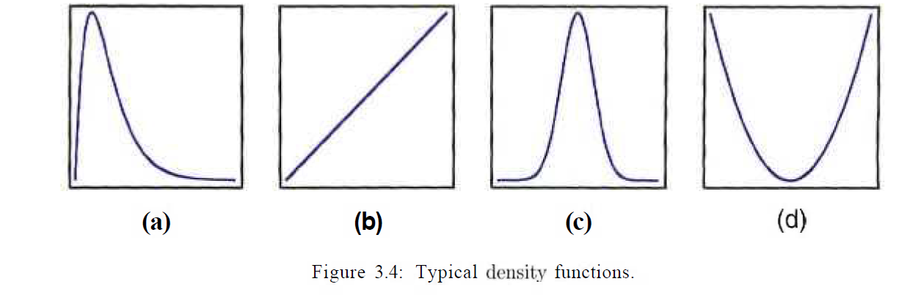
Density Functions

Slide 9
Continuous Probability Distributions
Let us discuss a random variable whose values are the heights of all people over 21 years of age.
Between any two values, say 163.5 and 164.5 centimeters, or even 163.99 and 164.01 centimeters, there are an infinite number of heights, one of which is 164 centimeters
probability of selecting a person at random who is exactly 164 centimeters tall and not one of the infinitely large set of heights so close to 164 centimeters that you cannot humanly measure.
So we talk about the probability of selecting a person who is at least 163 centimeters but not more than 165 centimeters tall

Slide 10
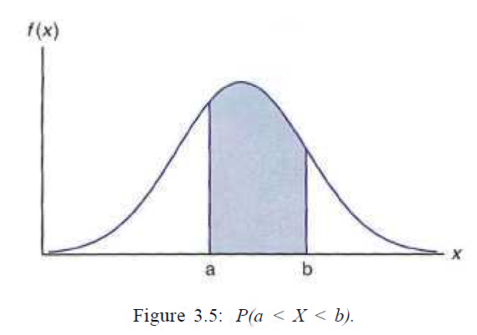
Density Function
probability that X assumes a value between a and b is equal to the shaded area under the density function between the coordinates at x = a and x = b, and from integral calculus is given by
P(a < X < b) = ʆ_{a}^{b} f(x) dx.

Slide 11
Binomial Distribution
Binomial distribution is used to model the probability distribution of number of successes(X) in finite number of Bernoulli trials(n).
Bernoulli Trial: A trial(performance of random experiment) which can result in only two possible outcomes, one of which is called success and other is called failure.
Example: if a new drug is introduced to cure a disease, it either cures the disease (it’s successful) or it doesn’t cure the disease (it’s a failure)

Slide 12
Assumptions under Bernoulli Distribution
Number of trials n is finite and fixed.
Trails are independent of each other.
Each trial has only two possible outcomes.
Probability p of success is constant from trial to trial.

Slide 13
Definition(Binomial distribution)
A discrete random variable X said to follow Binomial Distribution with parameters n and p, if its probability mass function is given by
p(x)= P(X=x)= ^{n}C_{x}p^{x}q^{n-x} for x = 0,1,2…. n, 0<p<1, p+q=1
=0 otherwise
In shorthand notation, it is represented as
X∼B(n, p)

Slide 14
Properties of Binomial Distribution
For Binomial Distribution with parameters n, p B(n, p)
Mean : µ = np
Variance (σ²) = npq
Since npq<np the variance of a Binomial Variable is always less than its mean.
Mode: Depending on the value of the parameter λ, it may be unimodal or bimodal.
If (n + 1) p = m is an integer: Binomial distribution is bimodal with mode is at x = m and x = m – 1
If (n + 1) p is not an integer: Binomial distribution is unimodal with mode at the integer part of (n + 1) p.
Binomial distribution is positively skewed.
β₁=(p-q)²/npq>0
as n->∞, β₁->0, distribution becomes symmetric.

Slide 15
Properties of Binomial Distribution
Additive Property: If two Binomial distributions X₁∼B(n₁, p⁾ and X₂∼B(n₂, p) are added to give another random variable Y, then Y also follows a Binomial Distribution given by Y=X₁+X₂∼B(n₁+n₂,p).
Limiting distribution: as n->∞, Binomial distribution tends to normal distribution.

Slide 16
Binomial Distribution
A coin is tossed 10 times. What is the probability of getting exactly 6 heads?
formula: b(x; n, P) – _{n}C_{x} * P^{x} * (1 – P)^{n – x} The number of trials (n) is 10 The odds of success (“tossing a heads”) is 0.5 (So 1-p = 0.5) x = 6
P(x=6) = ₁₀C₆ * 0.5^6 * 0.5^4 = 210 * 0.015625 * 0.0625 = 0.205078125

Slide 17
Binomial Distribution
80% of people who purchase pet insurance are women. If 9 pet insurance owners are randomly selected, find the probability that exactly 6 are women.
Step 1: Identify ‘n’ from the problem. Using our sample question, n (the number of randomly selected items) is 9.
Step 2: Identify ‘X’ from the problem. X (the number you are asked to find the probability for) is 6.
Step 3: Find p and q. p is the probability of success and q is the probability of failure. We are given p = 80%, or .8. So the probability of failure is 1 – .8 = .2 (20%).
Multiply your answer from formula together. 84 × .262144 × .008 = 0.176

Slide 18
Poisson Distribution
Poisson Distribution is used to model the number occurrences of a rare event in a small interval of time or space.

Slide 19
Real Life examples of Poisson Distribution
(1) Number of deaths from a disease, such as heart attack or cancer or due to snake bite.
(2) Number of suicides reported in a particular city.
(3) The number of defective material in a packing manufactured by a good concern.
(4) Number of faulty items in a packet of 100.
(5) Number of air accidents in some unit of time.
(6) Number of printing mistakes at each page of the book.
(7) Number of telephone calls received in some unit of time.
(8) Number of cars passing a crossing per minute during busy hours of
a day.

Slide 20
Poisson Distribution as a limiting case of Binomial Distribution
Poisson Distribution P(λ) also arises as a limiting distribution of Binomial Distribution B(n, p) under the following conditions:
1. Number of trails is large i.e. n->∞.
2. Probability of success is small i.e. p->0.
3. np ->λ , where λ is finite.(rate of event)

Slide 21
Definition(Poisson distribution)
A discrete random variable X said to follow Poisson Distribution with parameter λ, if its probability mass function is given by
p(x)= P(X=x)=e^{−λ}λ^{x}/x! for x = 0,1,2…. ∞, λ>0
=0 otherwise
In shorthand notation, it is represented as
X∼P(λ) e=2.71
λ= mean number of success that occur in specific region
X=Actual number of success that occur in specific region

Slide 22
Example
The average number of homes sold by the Acme Realty company is 2 homes per day. What is the probability that exactly 3 homes will be sold tomorrow?
Solution: This is a Poisson experiment in which we know the following:
μ = 2; since 2 homes are sold per day, on average.
x = 3; since we want to find the likelihood that 3 homes will be sold tomorrow.
e = 2.71828; since e is a constant equal to approximately 2.71828.
We plug these values into the Poisson formula as follows:
P(x; μ) = (e^{-μ}) (μ^{x}) / x! ➔ P(3; 2) = 0.180

Slide 23
Properties of Poisson Distribution
The mean of X∼P(λ) is equal to λ.
The variance of X∼P(λ) is also equal to λ. The standard deviation, therefore, is equal to +√λ.
Depending on the value of the parameter λ, it may be unimodal or bimodal.
If λ is an integer: Poisson distribution is bimodal with mode is at x = λ and x = λ – 1
If λ is an not an integer: Poisson distribution is unimodal with mode at the integer part of λ.

Slide 24
Properties of Poisson Distribution
Poisson distribution is positively skewed.
β₁=1/λ >0
as λ ->∞, β₁->0, distribution becomes symmetric.
Additive Property: If two Poisson distributions X₁∼P(λ₁) and X₂∼P(λ₂) are added to give another random variable Y, then Y also follows a Poisson Distribution given by Y=X₁+X₂∼P(λ₁+λ₂).
Limiting Distribution: Poisson distribution tends to Normal distribution as λ ->∞

Slide 25
Normal Distribution
The Normal Distribution is the most important continuous probability distribution in statistics.
A vast number of random variables of interest, in every physical science and economics, are either approximately or exactly described by the normal distribution.
Moreover, it can also be used to approximate other probability distributions, thus justifying the usage of the word normal as in pertaining to the one that is mostly used.

Slide 26
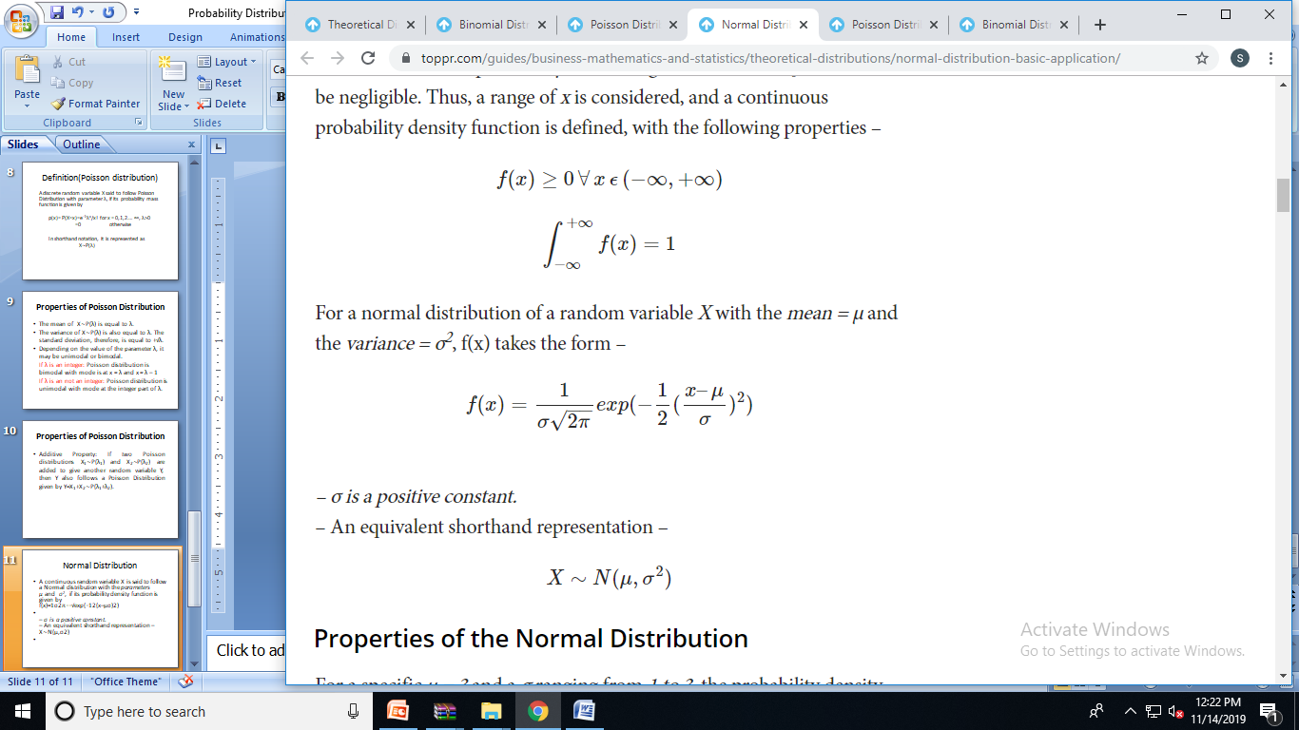
Normal Distribution
A continuous random variable X is said to follow a Normal distribution with the parameters μ and σ², if its probability density function is given by
where -∞<x< +∞, -∞<µ<+∞, σ>0
An equivalent shorthand representation is X∼N(μ,σ²)

Slide 27
Properties of Normal Distribution
The distribution is symmetric about the point x = μ and has a characteristic bell-shaped curve with respect to it. x-axis is an asymptote to the curve.
The mean, median and the mode of a normal distribution, all coincide with each other and are equal to μ.
Skewness is equal to zero i.e. Normal distribution is Symmetric.

Slide 28
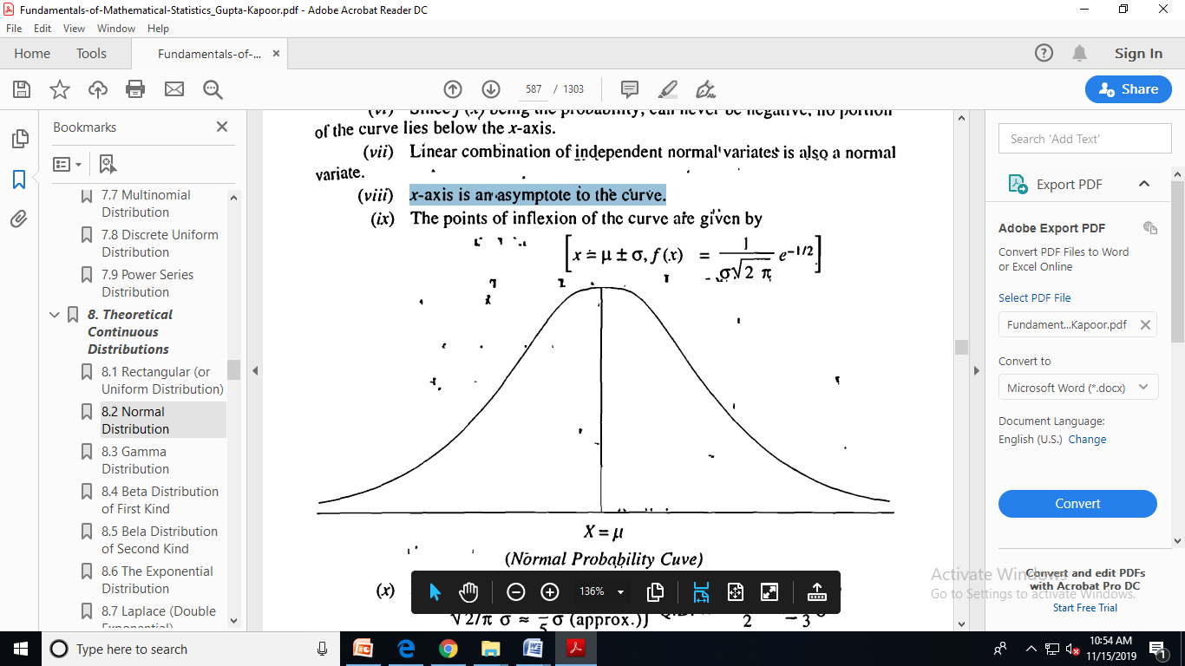

Slide 29
Properties of Normal Distribution
The Standard Deviation for this distribution is equal to σ.
x = μ ± σ are the points of inflection of Normal curve.
Additive Property: If X₁∼N(μ₁,σ₁²) and X₂∼N(μ₂,σ₂²), then Y=X₁+X₂∼N(μ₁+μ₂, σ₁² + σ₂²).

Slide 30
Area Property of Normal Distribution
P(μ – σ < X ≤ μ + σ) = 6826 ≈ 68.23%
P(μ – 2σ < X ≤ μ + 2σ) = 0.9544 ≈ 95.44%
P(μ – 3σ < X ≤ μ + 3σ) = 0.9974 ≈ 99.74%
These limits on X are called the one-, two- and three-sigma limits respectively.
Note that the probability of X lying beyond 3σ from the mean is 1 – 0.9974 = 0.0026 ≈ 0.26%.

Slide 31
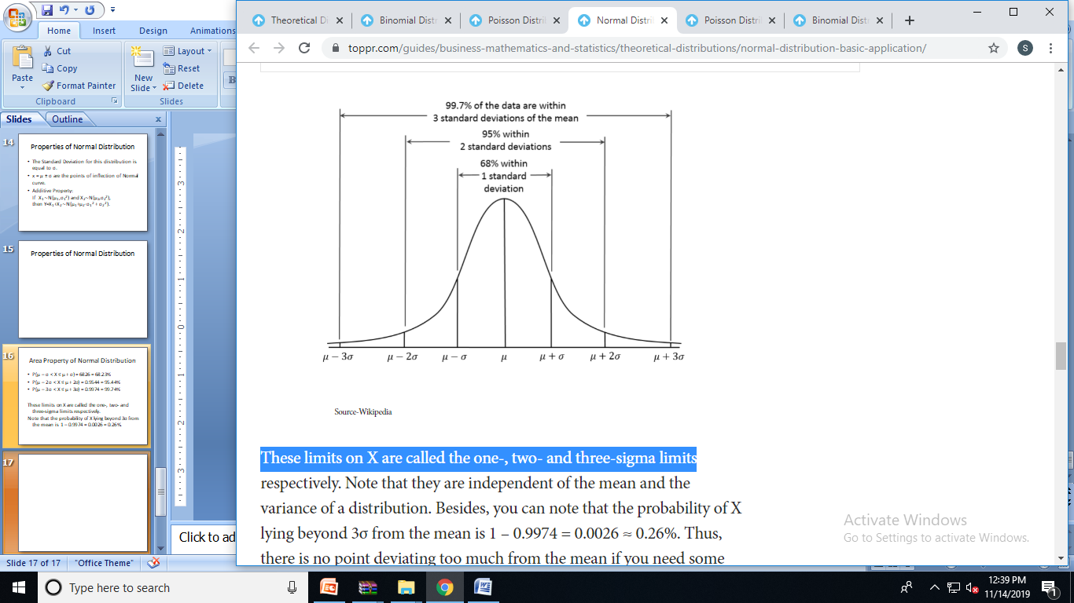
Area Property of Normal Distribution

Slide 32
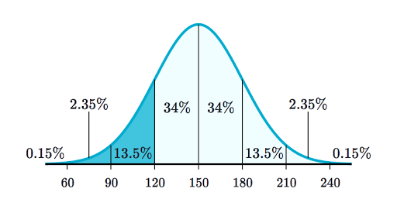
Area Property of Normal Distribution
The trunk diameter of a certain variety of pine tree is normally distributed with Mean=150, Standard Deviation=30
Draw a normal curve

Slide 33
Example
Approximately what percent of these trees have a diameter greater than 210 cm?
Step 1: Sketch a normal distribution with a mean of μ=150 cm and a standard deviation of σ=30 cm
Step 2: The diameter of 210 cm is two standard deviations above the mean. Shade above that point.
Step 3: Add the percentages in the shaded area:

Slide 34
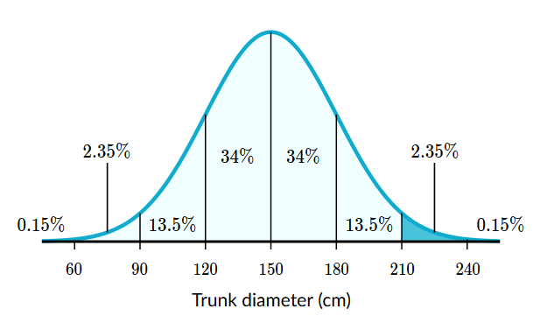
Example
2.35%+0.15%=2.5%
About 2.5% of these trees have a diameter greater than 210 cm

Slide 35
Example
A certain section of a forest has 500 of these trees. Approximately how many of these trees have a diameter smaller than 120 cm?
Step 1: Sketch a normal distribution
Step 2: The diameter of 120cm is one standard deviation below the mean. Shade below that point.
Step 3: Add the percentages in the shaded area:
0.15%+2.35%+13.5%=16%
About 16% of these trees have a diameter smaller than 120 cm

Slide 36
Example
Find how many trees in the forest that percent represents.
We need to find how many trees 16% of 500 is.
16% of 500 is 80
About 80 trees have a diameter smaller than 120 cm.

Slide 37
Home Work
Approximately what percent of these trees have a diameter between 90 and 210 centimeters?
Approximately how many of these trees have a diameter between 120 cm to 180 cm?
Step 1: Notice that 120 is 1 standard deviation below the mean, and 180 is 1 standard deviation above the mean.
Let's add the percentages between these boundaries:

Slide 38
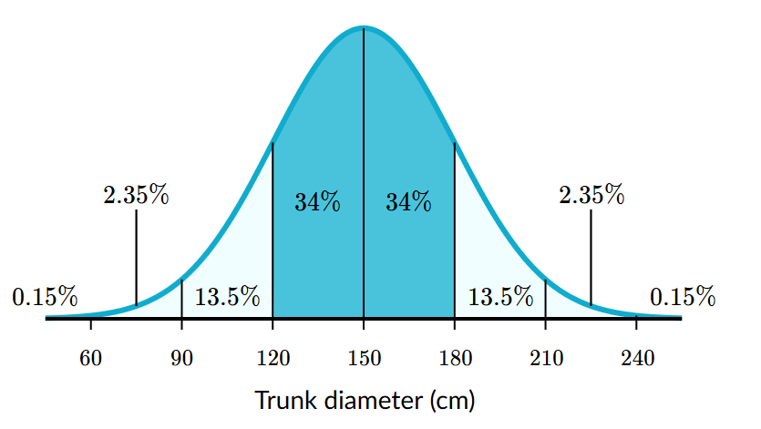
Home Work
34%+34%=68%
68% of these trees have a diameter between 120 to 180 cm
68% of 500=340

Slide 39
Standard Normal Variate and Distribution
If X∼N(μ,σ²) then a standard Normal Variate Z is defined
Z=(X- μ)/σ
Distribution of Z is called Standard Normal Distribution which is a Normal distribution with mean zero and variance 1.
i.e. Z∼N(0, 1)

Slide 40
Importance of Normal Distribution.
Most of the distributions occurring in practice, e.g., Binomial, Poisson, etc., can be approximated by Normal distribution.
Sampling distributions. e.g., ‘t' , F, Chi-square distributions, etc:, tend to Normal distribution for large samples.
If a variable is not Normally distributed, it can sometimes be brought to Normal form by simple transformation of variable.
The entire theory of small sample tests, viz., t, F, Chi-square tests-etc. is based on the fundamental assumption that the parent populations from which the samples have been drawn follow normal distribution.
Normal distribution finds large applications in Statistical Quality Control in industry for setting control limits.

Slide 41
Example
Bottom 30% of students failed an end sem exam. The mean for the test was 120 and standard deviation was 17. What was the passing score?
Z= x- μ /σ ➔ x = zσ+ μ
X=z*17+120
50%-30%=20%=0.20
Using z table we can find
value of z=0.20
By putting value x=123.4

Slide 42
Example
An average light bulb manufactured by the Acme Corporation lasts 300 days with a standard deviation of 50 days. Assuming that bulb life is normally distributed, what is the probability that an Acme light bulb will last at most 365 days?
Solution: Given a mean score of 300 days and a standard deviation of 50 days, we want to find the cumulative probability that bulb life is less than or equal to 365 days. Thus, we know the following:
The value of the normal random variable is 365 days.
The mean is equal to 300 days.
The standard deviation is equal to 50 days.
The answer is: P( X < 365) = 365-300/50=1.3 (0.90 from z table). Hence, there is a 90% chance that a light bulb will burn out within 365 days.

Slide 43
Example
X is a normally distributed variable with mean μ = 30 and standard deviation σ = 4. Find a) P(x < 40) b) P(x > 21) c) P(30 < x < 35)
For x = 40, the z-value z = (40 - 30) / 4 = 2.5 Hence P(x < 40) = P(z < 2.5) = [area to the left of 2.5] = 0.9938 (Z table)

Slide 44
Uniform Distribution
When you roll a fair die, the outcomes are 1 to 6. The probabilities of getting these outcomes are equally likely and that is the basis of a uniform distribution. Unlike Bernoulli Distribution, all the n number of possible outcomes of a uniform distribution are equally likely.

Slide 45
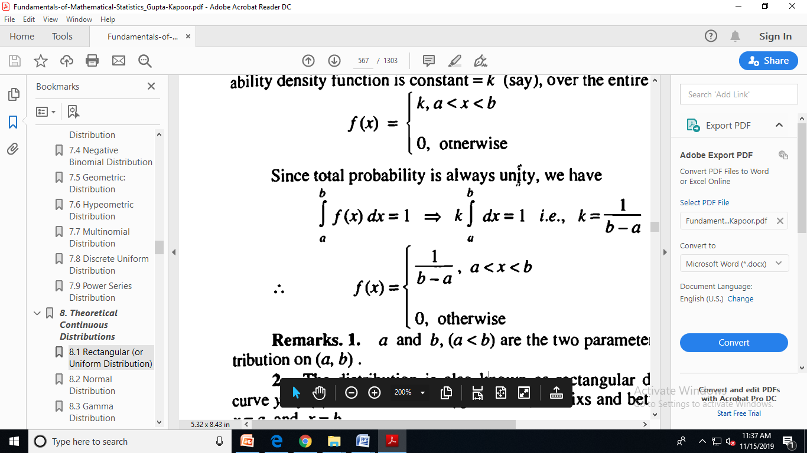
Uniform Distribution
A continuous random variable X is said to have a uniform distribution over an interval (a, b) if its probability density function is given by
a and b, (a < b) are the two parameters of the uniform distribution on (a, b) .

Slide 46
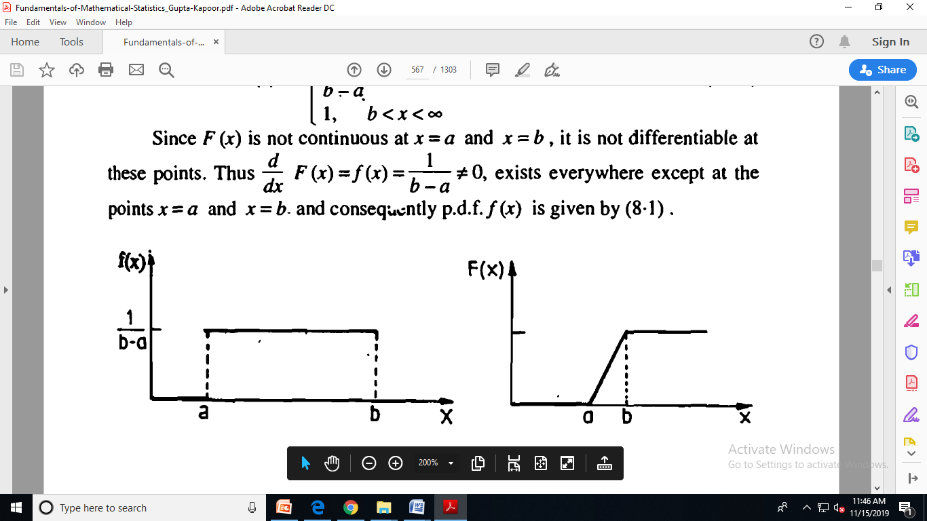
Uniform Distribution
The distribution is also known as rectangular distribution, since the curve y = f (x) describes a rectangle over the x-axis and between the ordinates at x = a and x =b.

Slide 47
Properties of Uniform Distribution
Mean= (b + a)/2
Variance = (b - a)²/12
Uniform distribution is symmetric.

Slide 48
Example
The number of bouquets sold daily at a flower shop is uniformly distributed with a maximum of 40 and a minimum of 10.
Let’s try calculating the probability that the daily sales will fall between 15 and 30.
The probability that daily sales will fall between 15 and 30 is (30-15)*(1/(40-10)) = 0.5
Similarly, the probability that daily sales are greater than 20 is = 0.667

Slide 49
Example
Suppose in a quiz there are 30 participants. A question is given to all 30 participants and the time allowed to answer it is 25 seconds. Find the probability of participants responds within 6 seconds?
Interval of probability distribution = [0 seconds, 25 seconds]
Density of probability = 1/25−0 = 1/25
Interval of probability distribution of successful event = [0 seconds, 6 seconds]
The probability P(x<6) =6-0/25
There are 30 participants in the quiz
Hence the participants likely to answer it in 6 seconds = 6/25 × 30 ≈ 7

Slide 50
Exponential Distribution
Let’s consider the call center example one more time. What about the interval of time between the calls ? Here, exponential distribution comes to our rescue. Exponential distribution models the interval of time between the calls.
Other examples are:
Length of time between metro arrivals,
Length of time between arrivals at a gas station
The life of an Air Conditioner
Exponential distribution is widely used for survival analysis. From the expected life of a machine to the expected life of a human, exponential distribution successfully delivers the result.

Slide 51
Properties of Exponential Distribution
Special case of gamma distribution
Is used to describe lifespan and waiting times
Can be used to describe times(waiting) between Poisson events
Mean=1/Ѳ
Variance=1/Ѳ²

Slide 52
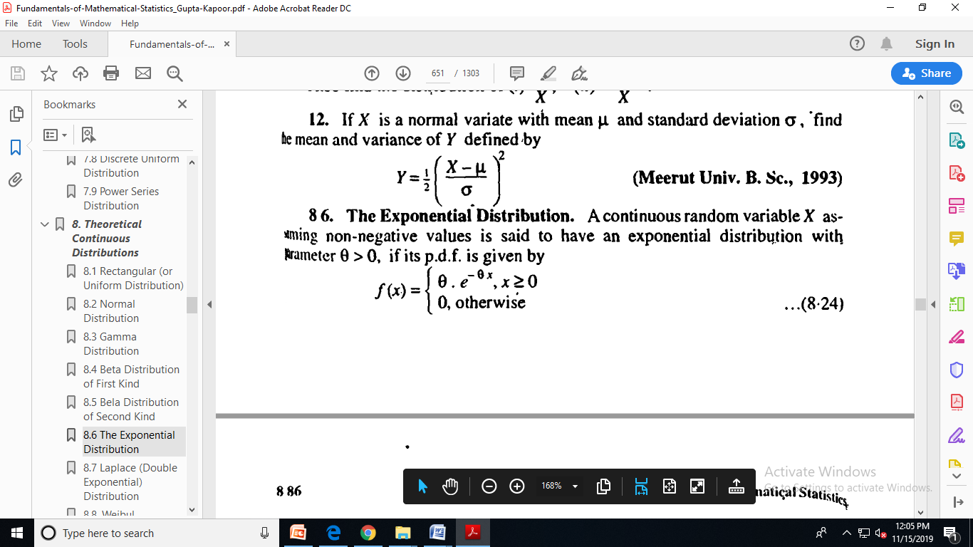
Exponential Distribution
A continuous random variable X taking non-negative values is said to have an exponential distribution with parameter Ѳ> 0, if its p.d.f. is given by

Slide 53
Exponential Distribution
Time between customer arrival at a post office is exponentially distributed with mean= 2 minute
One customer is just arrived. What is the probability that no other customer will arrive in the next period of 2 minutes?
P(x>=2) = 1-p(x<=2) = 1-ʃ₀² ½ e^{-x/2}dx
=e⁻¹ =0.368

Slide 54
Exponential Distribution
To ease the computation, there are some formulas given below. P{X≤x} = 1 – e^{-λx}, corresponds to the area under the density curve to the left of x.
P{X>x} = e^{-λx}, corresponds to the area under the density curve to the right of x.
P{x1<X≤ x2} = e^{-λx1} – e^{-λx2}, corresponds to the area under the density curve between x1 and x2.

